Slide 1
Smart Home
Mohamed Mohamed Mohamed Hassen Q9-Online
Yousef Mohamed Mohamed Ahmed Q9-Online
Mohamed Orabeya Q9-Online

Slide 2
Outlines
Problem statement
Problem solving
System construction
System instruction
Flow chart
Architecture
Simulation
GitHub Repo Link

Slide 3
Problem statement
Our traditional homes are suffers from lack in communication between the home and its resident.
No feedback if something went wrong as:
The door is closed or not .
Fire alert during work.
Forgetting the Ac on for a long time.
Anonymous person enters the home while you not existing there.

Slide 4
Problem solving
Smart home is the brilliant solution for all the previous information.
Smart home provide an access to the resident to check the at anytime & everywhere.
Smart home includes some sensors that fix the previous problems:
Door sensor: to check whether the door is closed or not.
Fire sensor is connected to LAN network to give you a mobile alert notification.
Schedule notification to remind you that the AC is working.
Internal cameras and sensors to avoid theft.

Slide 5
System construction
System is consists of 2 microcontroller an Bluetooth module.
Our system is based on Bluetooth connection between a mobile device and master microcontroller.
Master microcontroller send instruction to the slave one.
The sent instruction is based on the instruction sent by the user via Bluetooth.

Slide 6
System construction
Via Bluetooth
Mobile device
Send instruction
Bluetooth module
Send
instruction
Via UART
Do instruction
Slave
Microcontroller
SPI connection
Master
Microcontroller

Slide 7
System instruction
System has 2 outputs: AC and light system.
Output form is based on the instruction sent from mobile device.
Instructions are:
TURN AC ON ONLY.
TURN AC OFF ONLY.
TURN LIGHT ON ONLY.
TURN LIGHT OFF ONLY.
TURN ON BOTH.
TURN OFF BOTH.

Slide 8
System instruction
Instructions description :
TURN AC ON ONLY : master send address 0x10 to slave microcontroller, so the slave microcontroller will turn on the AC only.
TURN AC OFF ONLY : master send address 0x20 to slave microcontroller, so the slave microcontroller will turn off the AC only.
TURN LIGHT ON ONLY : master send address 0x30 to slave microcontroller, so the slave microcontroller will turn on the light only.
TURN LIGHT OFF ONLY : master send address 0x40 to slave microcontroller, so the slave microcontroller will turn off the light only .
TURN ON BOTH : master send address 0x50 to slave microcontroller, so the slave microcontroller will turn on both AC and light.
TURN OFF BOTH : master send address 0x60 to slave microcontroller, so the slave microcontroller will turn off both AC and light.

Slide 9
Architecture
Our design based on layered Architecture for each microcontroller.
Master microcontroller has 3 software module of MCAL(microcontroller abstraction layer):
Input / output module.
SPI module.
UART module
Slave microcontroller has 2 software module of MCAL (microcontroller abstraction layer):
Input / output module.
SPI module.

Slide 10
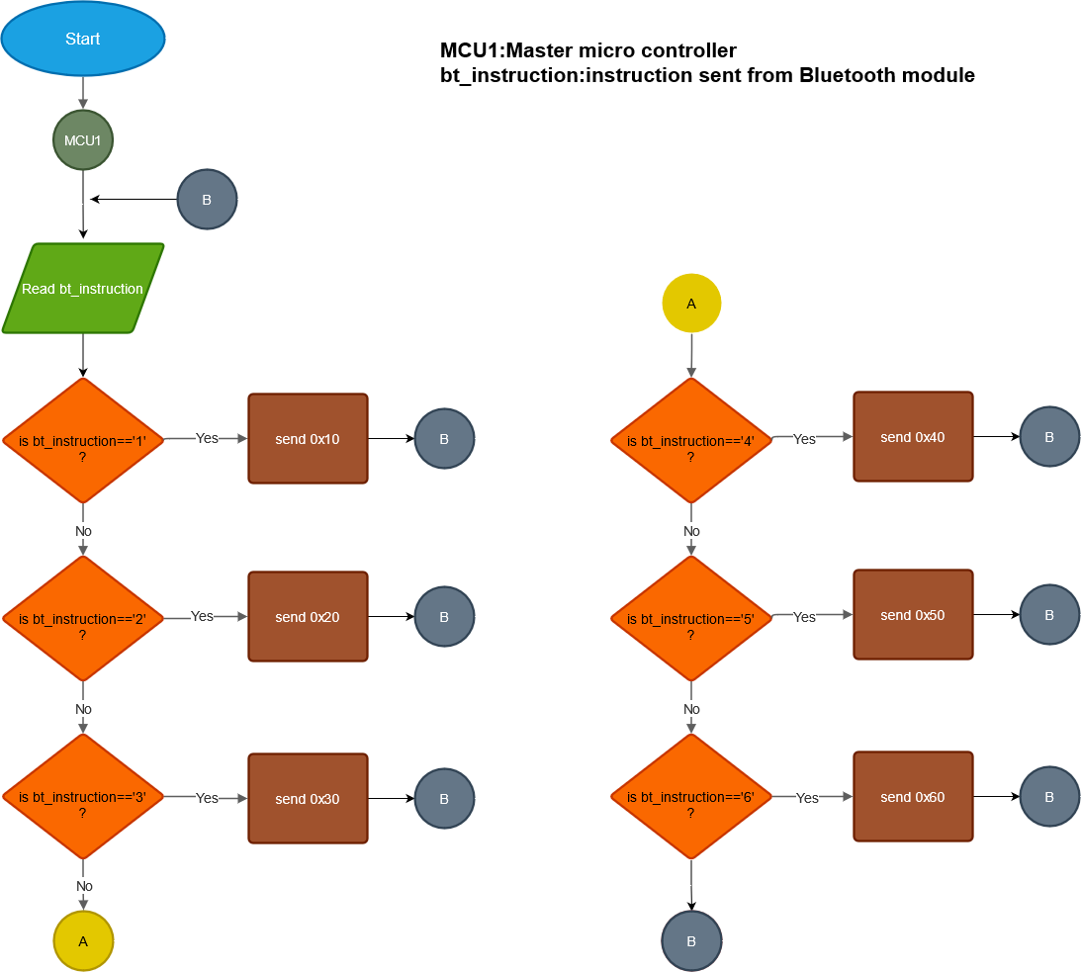
Flow chart

Slide 11
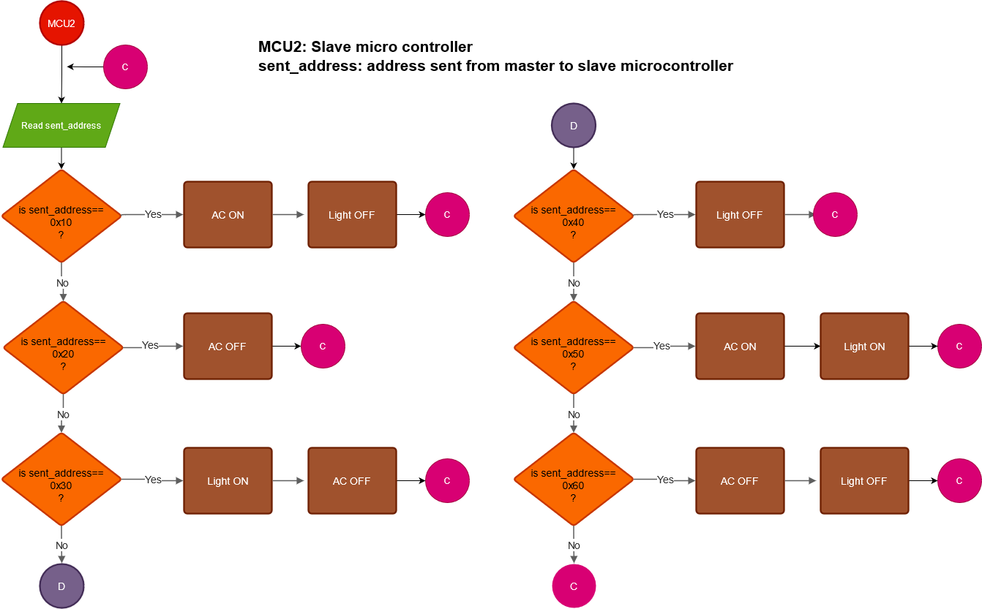
Flow chart

Slide 12
Architecture
Each software module is composed of 3 files:
Private.h (contains private information that can’t be shared with the user).
Interface.h (contains information as prototypes, macros & function used).
Program.h (contains main logic of the used functions).
The main code includes the interface files of each module in order to be called.

Slide 13
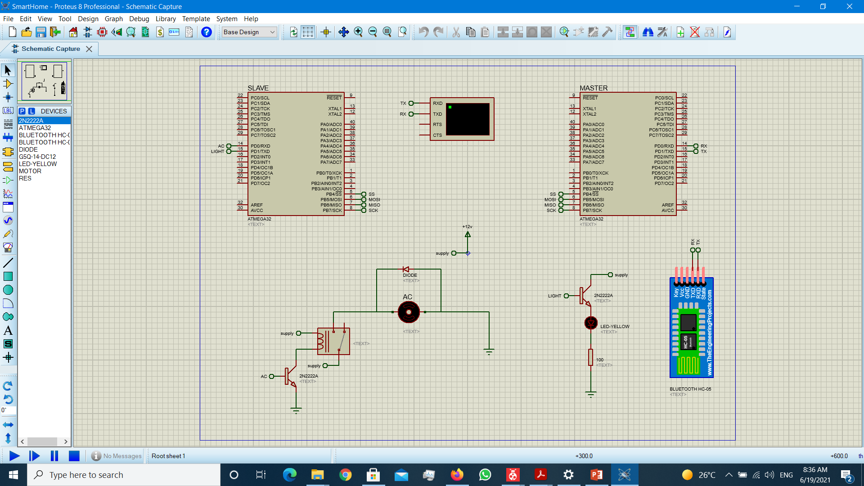
Simulation
System simulation is done by PROTEUS simulation in order to test whole the system. (check the PROTEUS file for real-time simulation)

Slide 14
GitHub Repo Link
Mohamed Hassen’s link:
https://github.com/Muhamed1470/smart-home.git
Yousef Mohamed’s link:
https://github.com/yousefmohammed98/smart-home.git
Mohamed Orabeya’s link:
https://github.com/Orabya/Smart-home.git

